Slide 1
Discrete-Event System Simulation
An Introduction to the Basic Principles of Simulation

Slide 2
Required Text
“Discrete-Event System Simulation”
5th Edition
Banks/Carson/Nelson/Nicol
Other editions are probably adequate, but not exactly as the 5th.

Slide 3
Modeling
Modeling involves observing a system, noting the various components, then developing a representation of the system that will allow for further study of or experimentation on the system
Focus – computer model
  Data Structures & Implementation
  Interaction of the components

Slide 4
Simulation
The process of running a (computer) model of a real system to study or conduct experiments
  For understanding the model or its behavior
  To evaluate strategies for operation of the system
  Involves generation of an artificial history, used to draw conclusions about the real system

Slide 5

Modeling & Simulation
Often described as one process
Should distinguish between the two

Slide 6

Simulation as the
Appropriate Tool
Enables study and experimentation
Changes simulated & results observed
Gain knowledge of system
Determining importance of variables and how variables interact
Experiment before implementation
Verify analytic solutions

Slide 7
Simulation as the
Appropriate Tool (cont’d.)
Try different capabilities (of a machine)
Training
Animation (graphics)
Complexity of modern systems almost require simulation

Slide 8
When Simulation is
Not Appropriate
If can be solved by
  Common sense or simple calculations
  Analytical methods
  Direct experiments
If simulation costs exceed savings
If resources & time are not available

Slide 9
When Simulation is
Not Appropriate (cont’d.)
If Data is not available
If verification & validation are not practical due to limited resources
If users have unreasonable expectations
If system behavior is too complex

Slide 10

Advantages of Simulation
1. Control
2. Time compression
3. Sensitivity Analysis
4. Training tool
5. Doesn’t disturb real system

Slide 11

Advantages
(Pegden, et al. 1995)
New policies, operating procedures, decision rules, information flows, organizational procedures, etc. can be explored w/o disrupting ongoing operations
New hardware designs, physical layouts, transportation systems, etc. can be tested w/o committing resources for their acquisition
Hypotheses about how or why certain phenomena occur can be tested for feasibility

Slide 12
Advantages #2
Time can be compressed or expanded allowing for speedup or slowdown of the phenomena under consideration
Insight about the interaction of variables or the importance of variables on performance of the system
Bottleneck analysis can be performed indicating where processes are being delayed
“What if?” questions can be answered – particularly for a new system

Slide 13

Disadvantages of Simulation
1. Expensive
2. Extensive time needed
3. Lack of experienced personnel

Slide 14
Disadvantages
(Pegden et al. 1995)
Model building requires special training and experience
Results may be difficult to interpret
Time consuming and expensive
Use of simulation when analytical models are available and preferable, particularly for closed-form models

Slide 15
Offsetting Disadvantages
Simulation Software
  Provides templates
  Analysis capabilities
  Faster simulations
Most systems do not fit closed-form models

Slide 16
Why Simulate?
  To save money
  To do things you could not physically or morally do within the actual system

Slide 17
Why is simulation not used more?
  Cost
  Lack of familiarity
  People think their judgment or experience is good enough

Slide 18

Areas of Application
Manufacturing, Semiconductor Mfg.
Construction & Project Management
Military
Logistics, Supply Chain, Distribution
Transportation & Traffic
Business Processes
Health Care

Slide 19
Current General Trends
Risk Analysis
  Insurance, options pricing, portfolio analysis
Call Center Analysis
Large Scale Systems
  Internet backbones, wireless networks, supply chains
Automated Materials Handling (AMHS)
  Control system sw - emulator

Slide 20
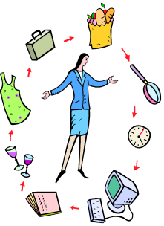
System
A set of inputs which pass through certain processes to produce outputs
A set of related components which work together toward a given goal
A group of objects joined in regular interactions or interdependence for the accomplishment of some purpose
  Helpful if a system is observable, measurable, systematic

Slide 21
System Environment
“World” in which the system exists
System is affected by elements outside the system – the system environment
Boundary – “line” between the system & its environment
Decision on boundary is dependent upon simulation purpose

Slide 22
System Components
Consists of objects called ENTITIES
Entities have a set of properties called ATTRIBUTES that describe them
There exist interactions called ACTIVITIES and or EVENTS that occur between the entities that cause them to change
The STATE OF A SYSTEM is a snapshot of the system at a given time
i.e. variables necessary to describe system
The model starts in its INITIAL STATE

Slide 23
Activities & Events
Cause changes in the attributes of the entities, and, therefore, the state of the system
Event: instantaneous
Activity: has a length of time

Slide 24
System Component Examples
Bank
Computer Network
Hospital Emergency Room
(Homework)

Slide 25
Activities & Events
2 types of Events or Activities
  Endogenous: variables affecting the system which are (can be) manipulated within the system
  Exogenous: variable which affect the system but cannot be manipulated by the system because they are outside the system.

Slide 26
Activities / Events
Problem!!!
  How can we determine the boundary of a system?
  What variables will be necessary and important in the simulation?

Slide 27
Classifications of Systems
1. Static (Monte Carlo) vs. Dynamic
2. Deterministic vs. Stochastic
3. Continuous vs. Discrete
  D: state vars. change at discrete points in time
  C: state vars. change continuously over time
Simulate
  Stochastic - Dynamic - Discrete or Continuous

Slide 28
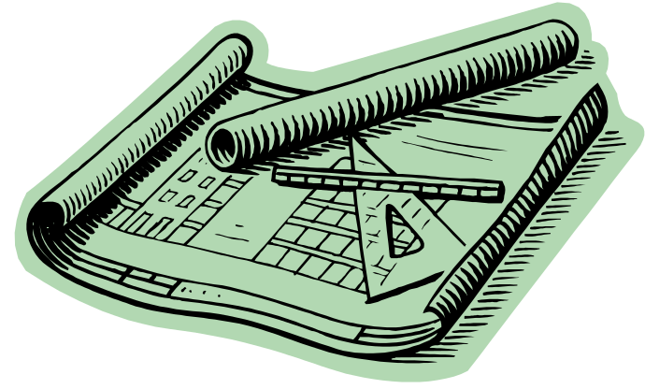
Model
The representation of an object in some form other than the form of the object itself, usually for the purpose of study or experimentation
Why Model???
  1. training or instruction
  2. to aid thought
  3. to aid communication
  4. prediction
  5. experimentation
  6. ** to aid decision making process

Slide 29
Classification of Models
1. Physical: an actual representation
2. Schematic: a pictorial representation
3. Descriptive: a verbal description
4. Mathematical: components are described mathematically, in the form of equations
5. Heuristics: descriptive model based on rules; algorithmic; - computer based

Slide 30
Characteristics of a Good Model
  Simple to understand
  Goal directed
  Robust
  Easy to control
  Complete on important issues
  Adaptive and easy to update
  Evolutionary

Slide 31
Steps in a Simulation Study
(Figure 1.3)
Problem Formulation
  Statement of the problem
Set Objectives & Project Plan
  Questions to be answered
  Is simulation appropriate?
  Methods, alternatives
  Allocation of resources
    People, cost, time, etc.

Slide 32
Steps in a Simulation Study
(cont’d.)
Model Conceptualization
  Requires experience
  Begin simple and add complexity
  Capture essence of system
  Involve the user
Data Collection
  Time consuming, begin early
  Determine what is to be collected

Slide 33
Steps in a Simulation Study
(cont’d.)
Model translation
  Computer form
  general purpose vs. special purpose lang.
Verification
  Does the program represent model and run properly? Common sense
Validated?
  Compare model to actual system
  Does model replicate system?

Slide 34
Steps in a Simulation Study
(cont’d.)
Experimental Design
  Determine alternatives to simulate
  Time, initializations, etc.
Production & Analysis
  Actual runs + Analysis of results
  Determine performance measures
More Runs?

Slide 35
Steps in a Simulation Study
(cont’d.)
Documentation & Reporting
  Program & Progress Documents
  Thoroughly document program – will likely be used over time
  Progress reports are important as project continues – history, chronology – changes, etc.
Implementation

Slide 36
Ten Reasons for Failure (notes)
1.Failure to define an achievable goal
2.Incomplete mix of essential skills
  Project leadership
  Modeling
  Programming
  Knowledge of modeled system
3.Inadequate level of user participation
4. Inappropriate level of detail
5.Poor communication

Slide 37
Failure (cont.)
6. Using the wrong computer language
7. Obsolete or Nonexistent Documentation
8. Using an unverified model
9. Failure to use modern tools and techniques to manage the development of a large complex computer program
10. Using Mysterious Results

Slide 38
Stochastic Behavior
  Monte Carlo
    Random, but not over time
    E.G. Darts on a dart board
  Pseudorandom
    Time dependent, Reproducible
    E.G. Customer arrivals

Slide 39
Problem: Simulate a major traffic intersection with objective of improving traffic flow.
Provide 3 iterations of increasing detail
  1. Problem Formulation
  2. Set objectives & overall project plan

Slide 40

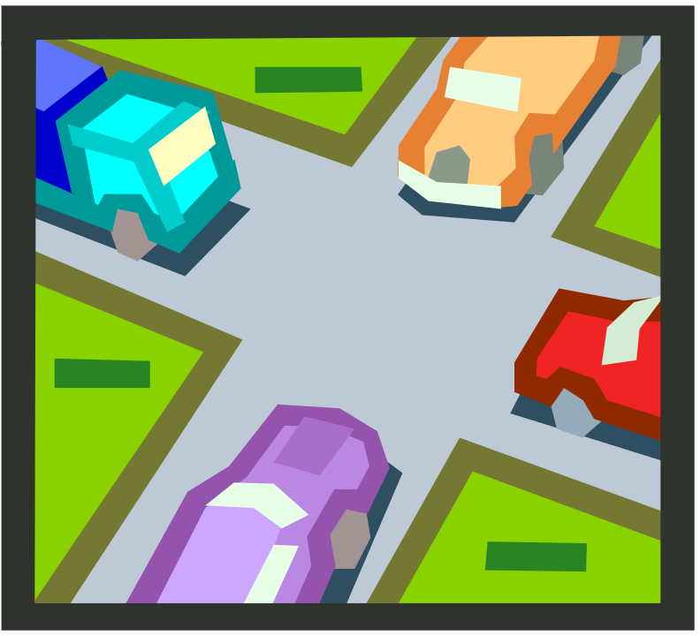
First Iteration
1. Traffic is congested
2. Reduce traffic congestion

Slide 41
Second Iteration
1. Traffic on westbound street A is backed up
2. Improve traffic flow, Westbound street A by modifying traffic light

Slide 42
Third Iteration
1. Westbound traffic on Street A, turning south onto street B cannot easily cross so traffic blocks up.
2. Improve traffic flow on Westbound Street A by making a turn only lane to the south with a protected turn traffic signal.

Slide 43
Homework
Problem 1 on page 22 – (a, d, e)
  Sketch a diagram of your view of each system
  For each system: Name 5 entities, 3 attributes of each entity, 5 activities, the 10 events corresponding to the 5 activities, 5 state variables
  Type up and turn in on (TBA)

Slide 44
Do Examples from Ch. 2

